Slide 1

Department of Mechanical Engineering Vishwakarma Institute of Technology, Pune.
HMAFP Course Project Review Presentation Topic:Design and CFD Analysis of Kaplan Turbines with & without Blade Twist and their Comparative Analysis and Validation
Batch 2 Group 2
Aarya Velankar
Tanishq Chavan
Rugwed Ushir
Krishna Vyas
Sarvesh Suryavanshi
Guide :
Prof. Dr. Sachin Komble

Slide 2
CONTENTS
Introduction
Objective
Literature Survey
Calculations for Common Turbine Inputs and Assumed Values
CAD
CFD Simulation
Results and Conclusions

Slide 3
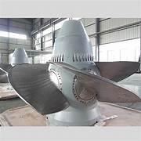
Introduction
A Kaplan turbine is a type of axial flow water turbine used in hydroelectric power plants.
It is specially designed for low head and high flow rate water conditions.
The turbine operates similar to a ship propeller working in reverse, where flowing water rotates the blades.
Kaplan turbines are widely used in large river-based hydropower projects like Bhakra-Nangal project , Hirakud Dam Project and Radhanagri Hydroelectric Scheme.
They can achieve efficiencies greater than 90%, making them one of the most efficient hydraulic turbines.

Slide 4
Objectives
To design a Kaplan turbine using theoretical design calculations.
To develop a complete 3D CAD model of the turbine assembly and compare it with another model with different blade geometry based on user inputs
To analyze the difference between theoretical performance and real-world behavior.
To use Computational Fluid Dynamics (CFD) to study flow characteristics.
To compare the performance of the 2 turbines which have similar use inputs but different blade geometries

Slide 5
Literature Survey Papers
Paper | Year | Focus Area | Method | Key Result
Abeykoon | 2022 | Kaplan turbine runner optimization | CFD + theoretical modeling | Efficiency improved to 93%
Arora et al. | 2024 | Turbine erosion analysis | Field study + IEC standards | Identified erosion rates
Sondhiya et al. | 2018 | Blade design optimization | CAD + CFD | 5.43% power increase
Khoddami et al. | 2025 | Sub-runner turbine design | CFD parametric analysis | Up to 41.7% efficiency improvement
Rehman et al. | ~2017–18 | Micro Kaplan turbine modeling | Analytical simulation | 6.68 kW micro turbine design

Slide 6
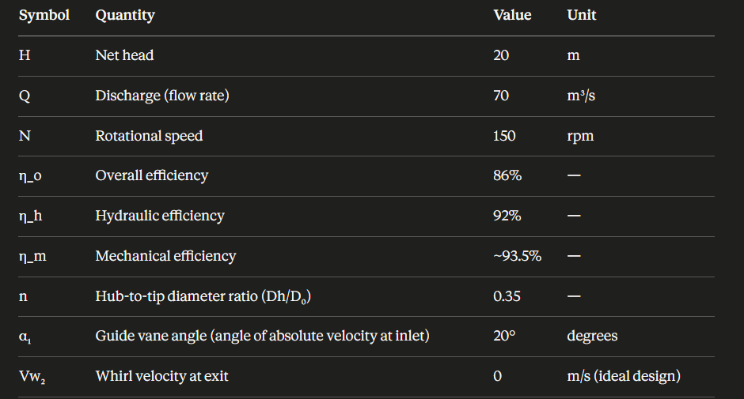
Calculations for Common Turbine Inputs and Assumed Values
These were some assumed values for performance variables of a Kaplan Turbine
These values were kept the same in case of both the turbines we compared so as to get the difference in performance based solely on the blade geometries

Slide 7
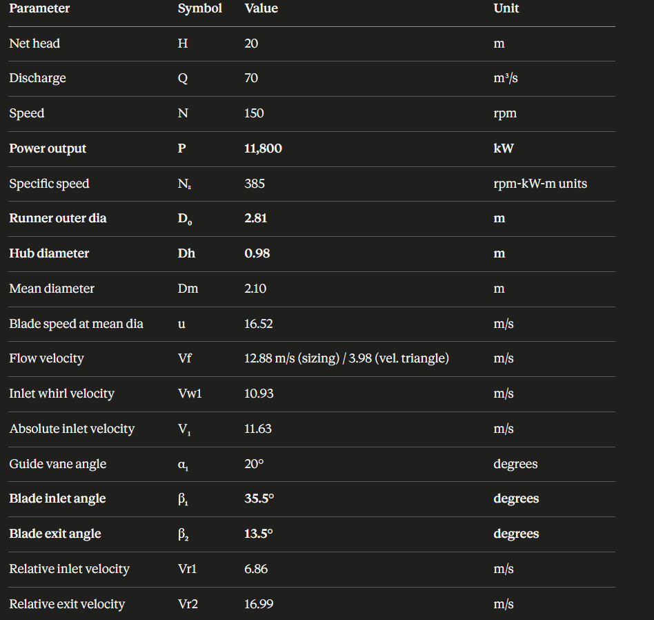
Calculations for Common Turbine Inputs and Assumed Values
These were the values that we got after calculations for design characteristics and velocities of Kaplan turbine
These values are considered as theoretical and will help us validate our CFD analysis
The relevant parameter values will be used for validation i.e. for example , we will consider absolute velocity for analysis and comparison instead of flow or whirl velocities

Slide 8
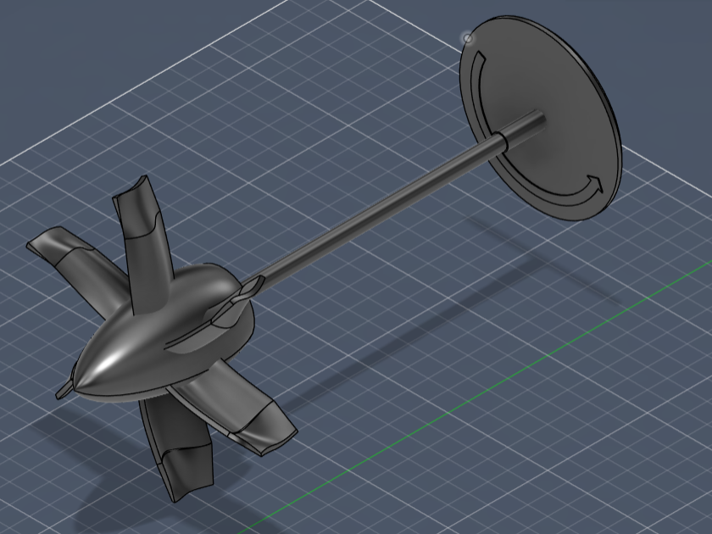
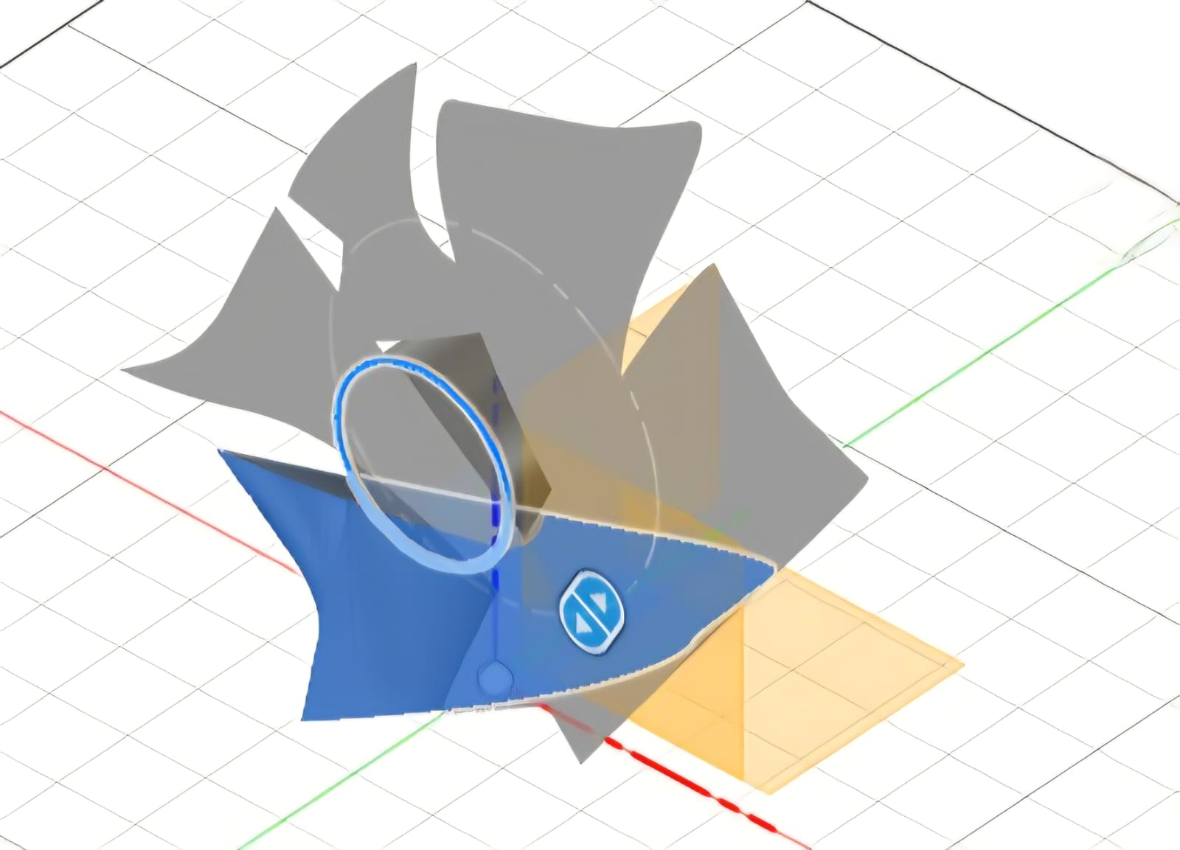
CAD
CAD for Kaplan Turbine 1 with blades without twist throughout its height
CAD for Kaplan Turbine 2 using blades that twist throughout its height

Slide 9
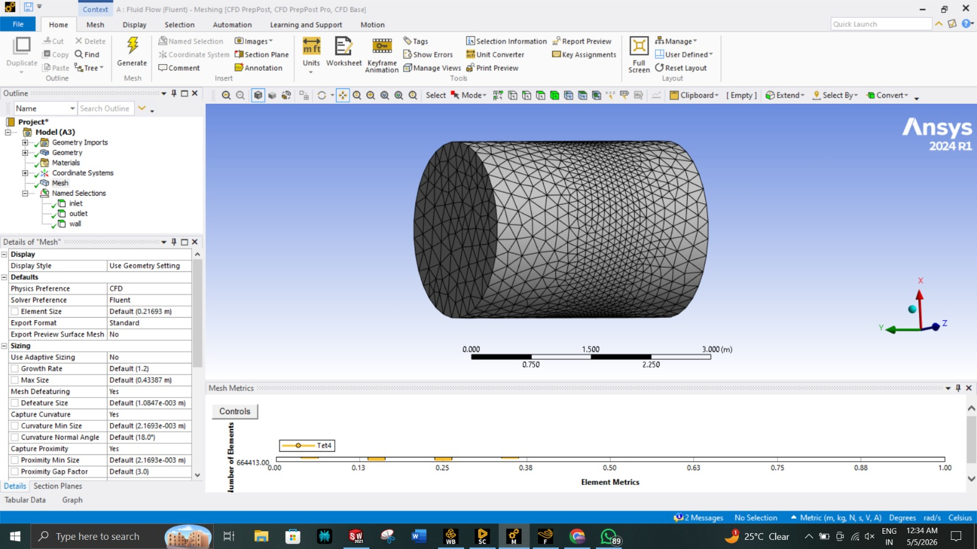
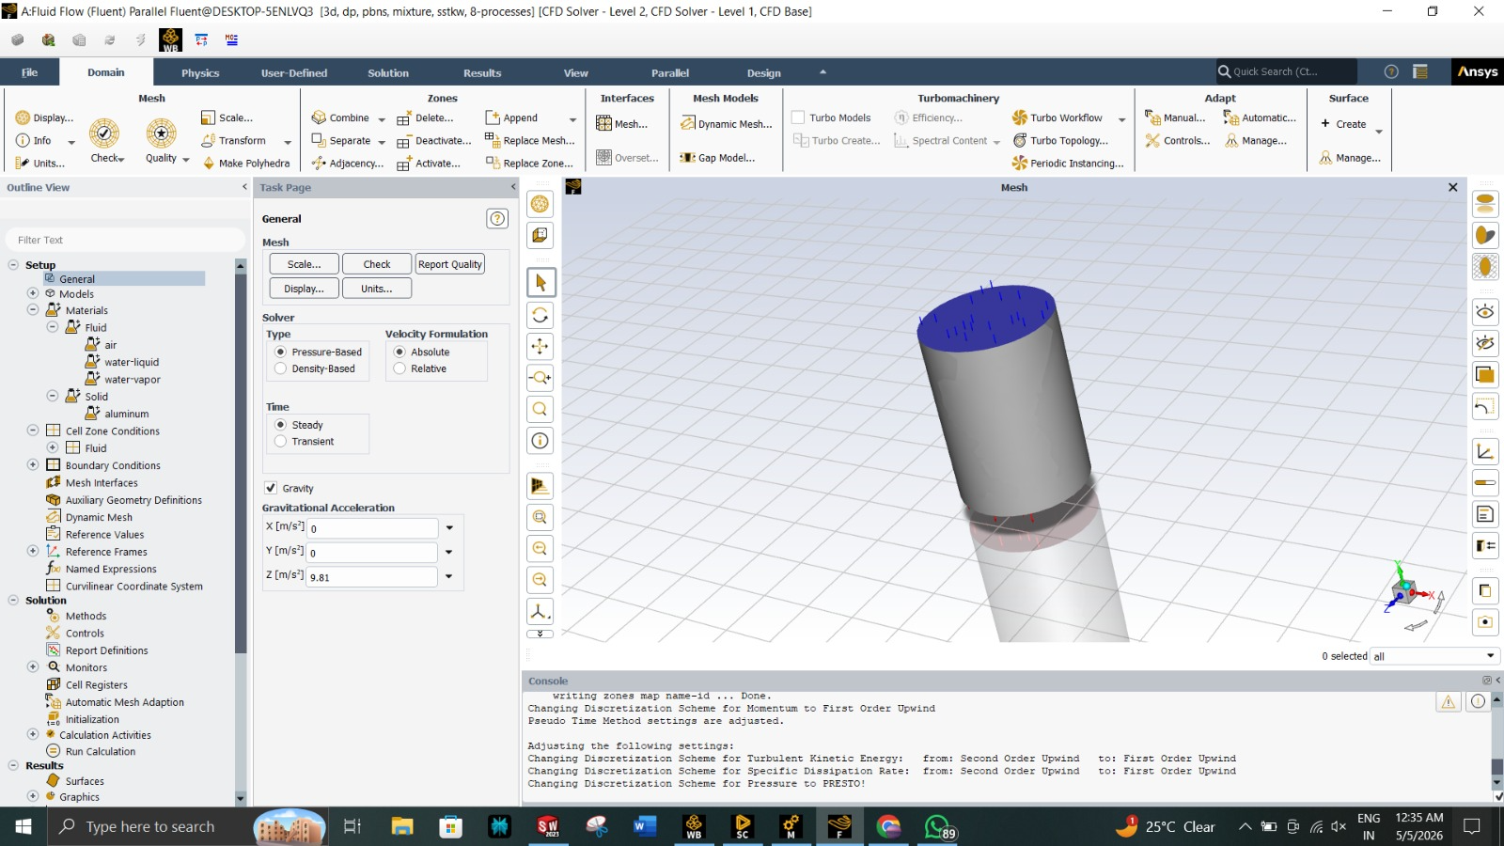
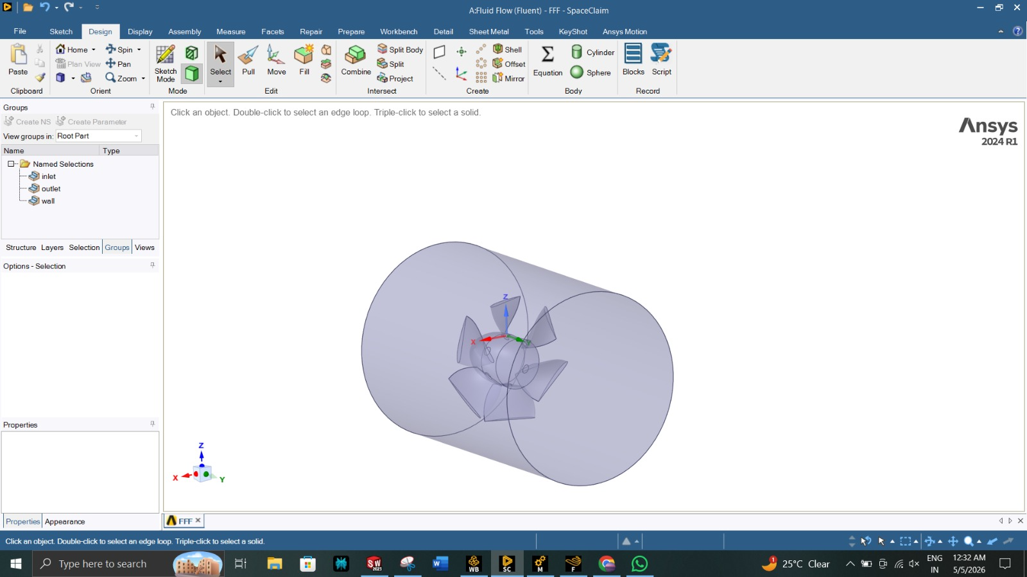
CFD Simulation
Meshing
Simulation
Solver type :
Pressure based
Absolute Velocity
K- epsilon solver
Solver specifications are kept same for both turbines
Meshing details :
Mesh used = Tetrahedron
Maximum Node size = 0.16 mm
Minimum Node size = 1 mm
Number of nodes = 4,26,363

Slide 10
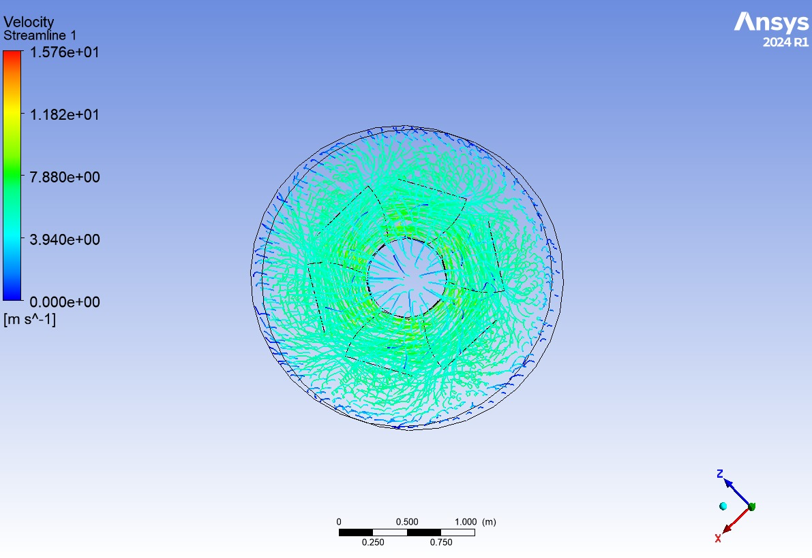
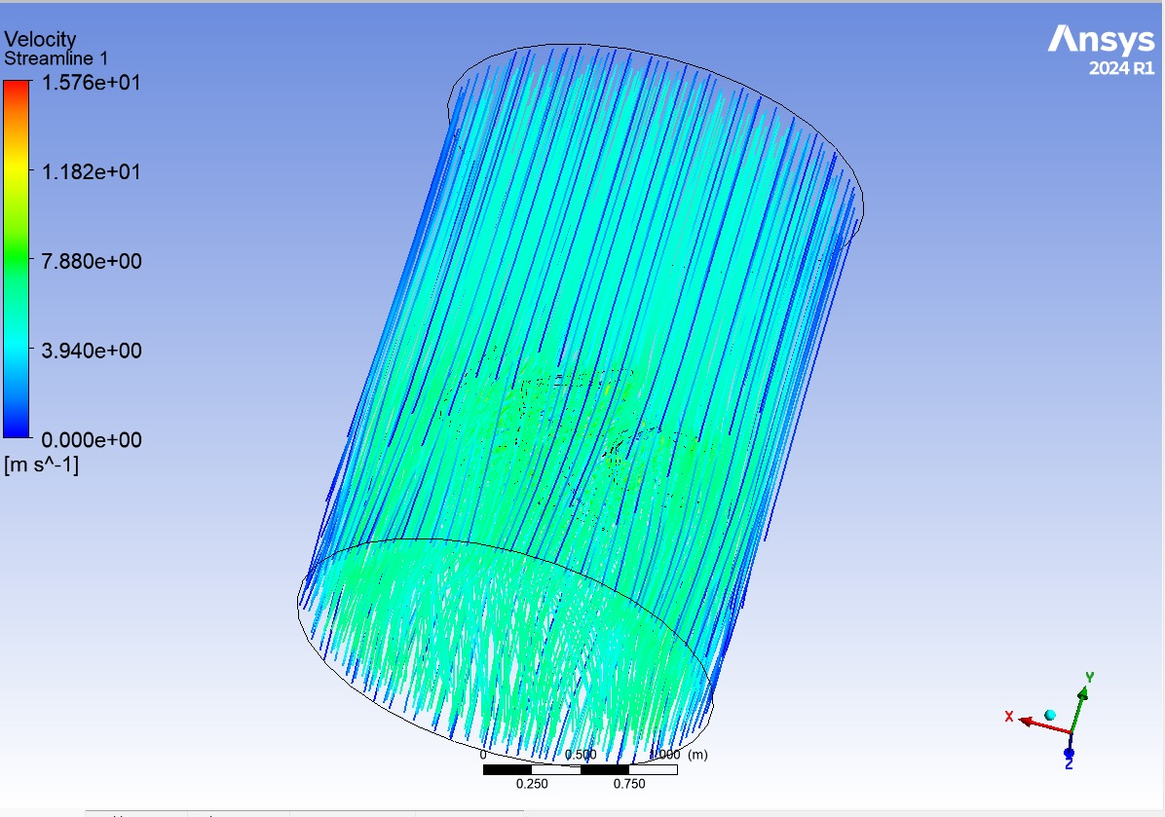
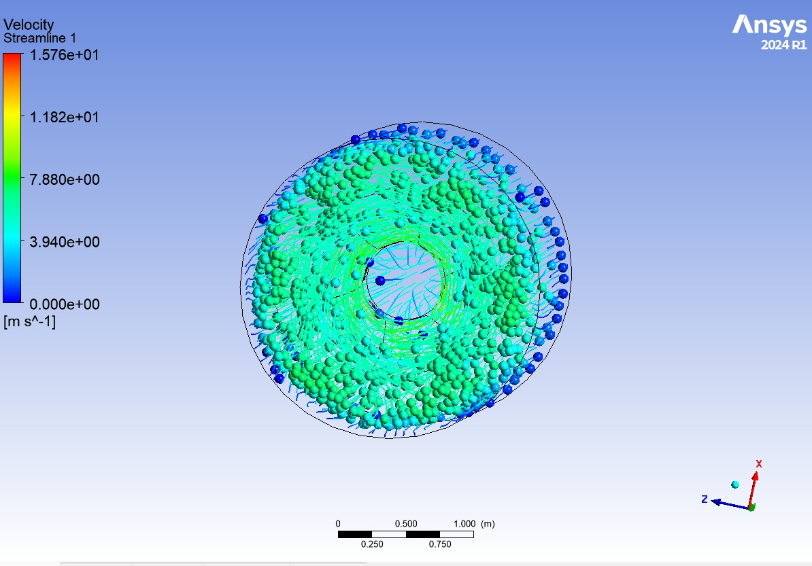
Streamline Contours
This shows the streamline flow inside the runner, indicating how water rotates and transfers energy to the blades.
This side view shows how water enters, flows through the turbine, and exits smoothly.
This image represents velocity distribution, where color variation indicates changes in flow speed and energy transfer.

Slide 11
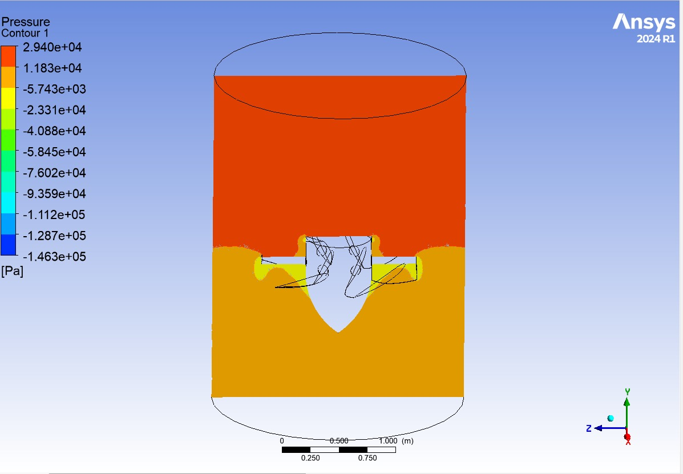
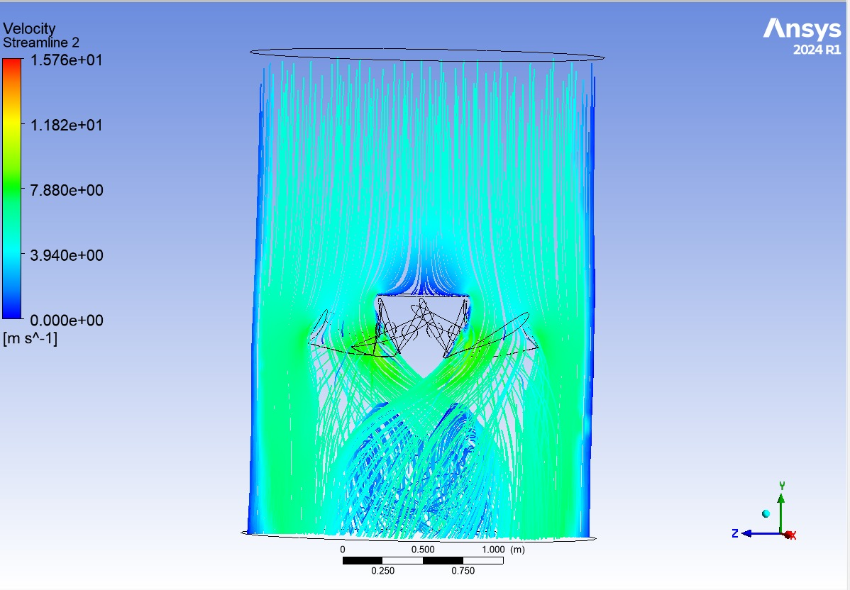
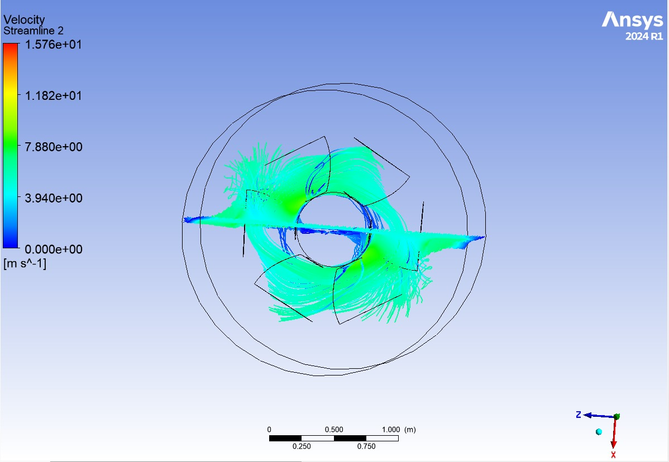
This image shows pressure distribution inside the turbine, where high pressure at the inlet reduces as energy is extracted by the blades.
This shows the flow of water through the turbine, where velocity increases near the blades indicating energy transfer.
This top view shows rotational flow inside the runner, highlighting how water interacts with blades to produce torque.

Slide 12
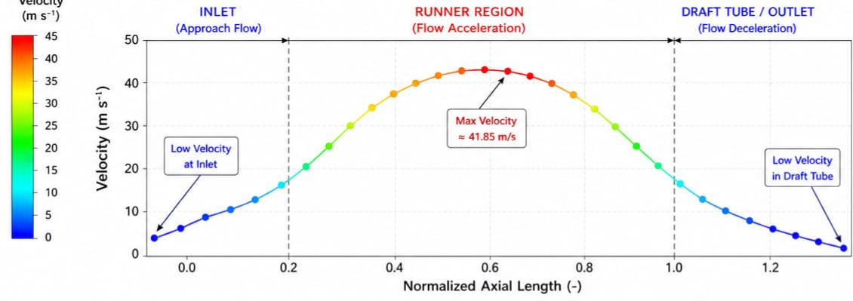
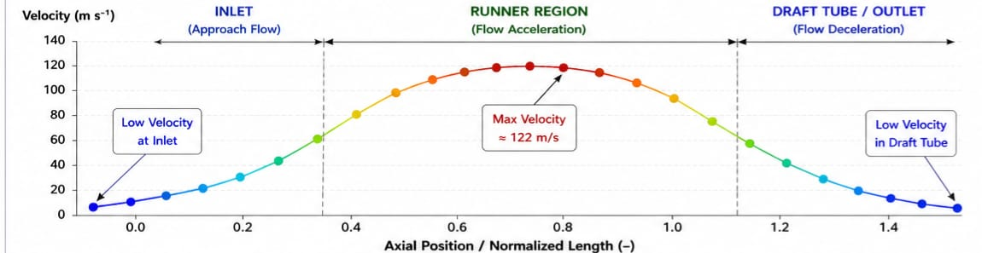
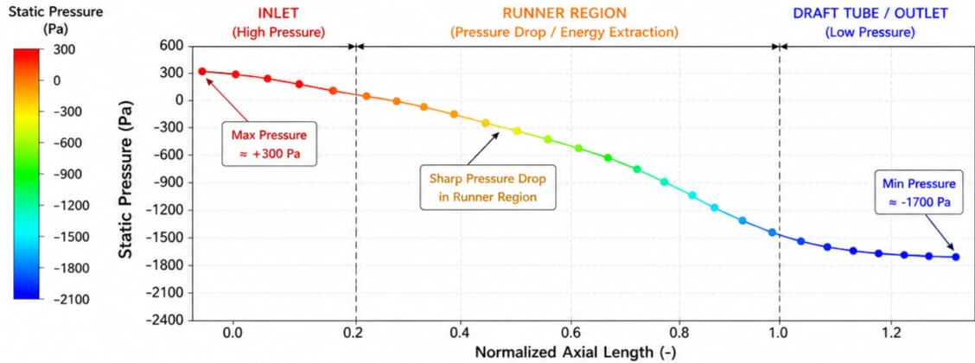
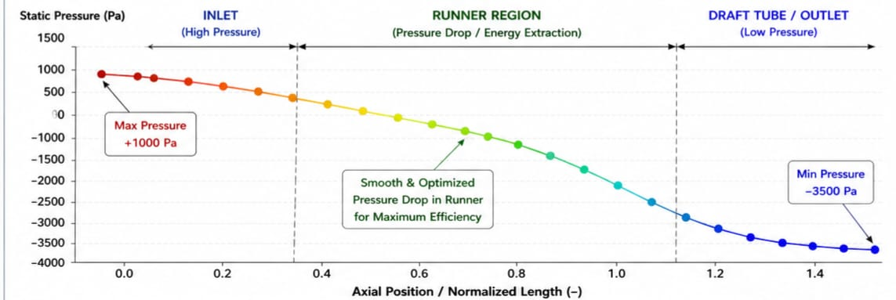
Results
Pressure and Velocity for Kaplan Turbine 1 with blades without twist throughout its height
Pressure and Velocity for Kaplan Turbine 2 using blades that twist throughout its height

Slide 13
Results and Conclusions
 | Turbine without Blade Twist | Turbine with Blade Twist
Velocity (m/s) | Max = 41.85 Min = 11.63 | Max = 122 Min = 11.63
Pressure (Pa) | Max = 300 Min = - 1700 | Max = 1000 Min = -3500
Overall Efficiency | 0.7648 | 0.9338
We can see an increased velocity in turbine 2 which means energy from water is being more efficiently converted to KE
We can see a higher pressure drop in turbine 2 which means that a higher pressure difference is obtained which leads to a higher conversion of water energy to a pressure head
This shows that a better conversion of available energy is being done in the turbine by conversion to pressure head and velocity head
This leads to a better efficiency value than turbine 1 (increase of almost 20% is seen)
The negative pressure values indicate a turbulent flow with formation of whirls
Increased whirl velocity means more flow velocity which means more discharge i.e. this is analogous with the characteristics of axial flow turbines

Slide 14


